Slide 1
Exception Handling
Handling Errors During the Program Execution

Slide 2
Table of Contents
What are Exceptions?
Handling Exceptions
The System.Exception Class
Types of Exceptions and their Hierarchy
Raising (Throwing) Exceptions
Best Practices
Creating Custom Exceptions

Slide 3
What are Exceptions?
The exceptions in .NET Framework / Java are a classic implementation of the OOP exception model
Deliver powerful mechanism for centralized handling of errors and unusual events
Substitute procedure-oriented approach, in which each function returns error code
Simplify code construction and maintenance
Allow the problematic situations to be processed at multiple levels

Slide 4
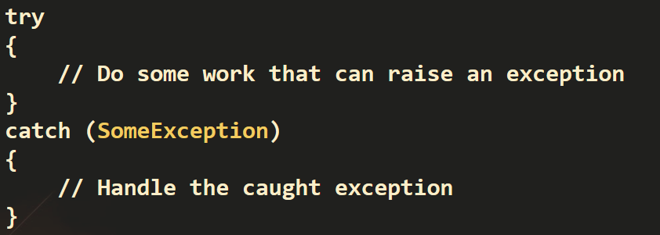
Handling Exceptions
In C# exceptions can be handled by the try-catch-finally construction
catch blocks can be used multiple times to process different exception types

Slide 5
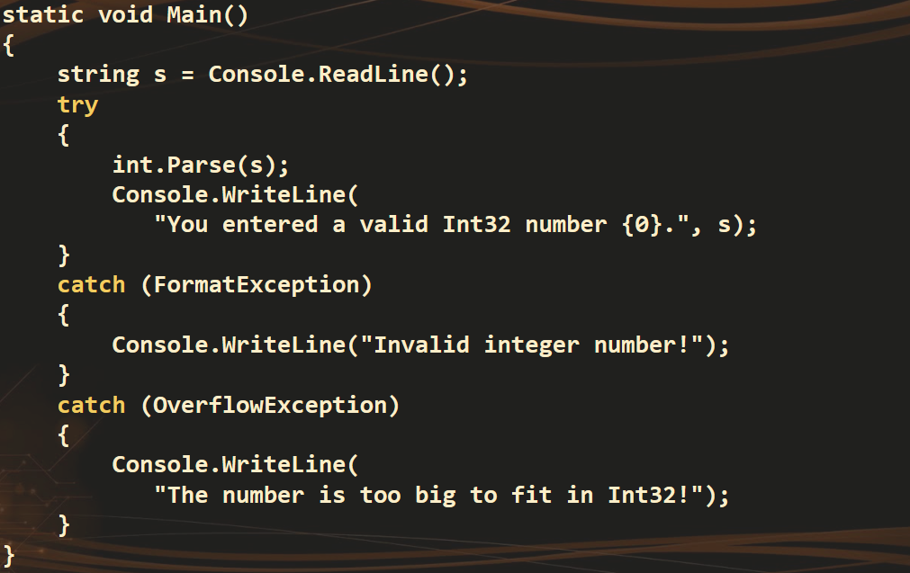
Handling Exceptions – Example

Slide 6
The System.Exception Class
Exceptions in C# / .NET are objects
The System.Exception class is base for all exceptions in CLR
Contains information for the cause of the error / unusual situation
Message – text description of the exception
StackTrace – the snapshot of the stack at the moment of exception throwing
InnerException – exception caused the current exception (if any)
Similar concept in Java and PHP

Slide 7
Exception Properties
The Message property gives a brief description of the problem
The StackTrace property is extremely useful when identifying the reason that caused the exception

Slide 8
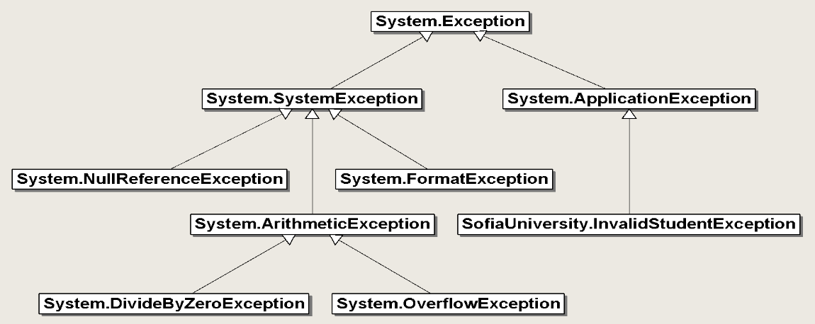
Exception Hierarchy in .NET

Slide 9
Types of Exceptions
.NET exceptions inherit from System.Exception
The system exceptions inherit from System.SystemException
System.ArgumentException
System.FormatException
System.NullReferenceException
System.OutOfMemoryException
System.StackOverflowException
User-defined exceptions should inherit from System.Exception

Slide 10
Throwing Exceptions
Exceptions are thrown (raised) by the throw keyword
Used to notify the calling code in case of error or unusual situation
When an exception is thrown:
The program execution stops
The exception travels over the stack
Until a matching catch block is reached to handle it
Unhandled exceptions display an error message

Slide 11
Using throw Keyword
Throwing an exception with an error message:
throw new ArgumentException("Invalid amount!");
Exceptions can accept message and cause:
Note: if the original exception is not passed, the initial cause of the exception is lost
try
{
…
}
catch (SqlException sqlEx)
{
throw new InvalidOperationException("Cannot save invoice.", sqlEx);
}

Slide 12
Choosing the Exception Type
When an invalid parameter value is passed to a method:
ArgumentException, ArgumentNullException, ArgumentOutOfRangeException
When requested operation is not supported
NotSupportedException
When a method is still not implemented
NotImplementedException
If no suitable standard exception class is available
Create own exception class (inherit Exception)

Slide 13
Exercise 1 - Persons
Define a class Person that has name, age and email. The name and age are mandatory. The email is optional. Define properties that accept non-empty name and age in the range [1 ... 100]. In case of invalid arguments, throw an exception.
Define a property for the email that accepts either null or non-empty string containing “@”.
Define two constructors.
The first constructor should take name, age and email.
The second constructor should take name and age only and call the first constructor.
Implement the ToString() method to enable printing persons at the console.
Create a program asking user for Name, Age and Email (optional).
Program should add data into list of Persons.
In case of exception program should display appropriate message.
Program should be able to display list of Persons upon request.

Slide 14
Exercise 2 - Calculator
Create class Calculator with properties ValueA, ValueB, Operation and a method to calculate result. Create a program asking about two values and operation. After user select operation program should display the result as: [value 1] [operator] [value 2] = [result] In case of exception program should display appropriate message. Example results: 2 + 2 = 4 2 / 2 = 1 2 / 0 = DivideByZeroException

Slide 15
Useful links
https://csharp-by-example.blogspot.bg/
https://www.tutorialspoint.com/csharp/csharp_exception_handling.htm

